Slide 1
PDQ Project Estimation
Eric N. Opp, PMP
Business Performance Systems
E-Mail: Eric.Opp@BPSConsulting.com
Tel.: (571) 218-9428

Slide 2
Your Benefit
Learn how to create an initial, top-down project estimate that can be used as either a starting point for discussion with executive management or as a price estimate to be submitted to your customer.

Slide 3
Agenda
Basic Terms
Assumptions
A Scenario
The Process
Working Through the Scenario
Questions

Slide 4
Basic Terms
Estimate
  Calculated approximation of an uncertain event or process.
What is the difference between the cost and the price?
  The cost is what you estimate and the price is what the market will bear.
How accurate?
  +- 20%
Would you use a different approach for different types of contracts?
  Of course!! You will add contingencies to an Firm, Fixed Price that you might not add to a Time & Materials estimate.

Slide 5
Assumptions
Requires Top-Down estimating, because there is simply not enough time to do Bottom-Up
Create Estimates that primarily involve:
  Contracts for the Federal Government.
  Services as opposed to Other Direct Costs or materials
  Cost/price build-up that is approved and submitted
You have access to some performance data on prior contracts/projects through you colleagues

Slide 6
A Scenario
It is 1:00PM, your manager comes and tells you the following:
“I have a Task Order RFP here. It is for about $1million of work. I need a Task Order Proposal along with an approved Price Proposal to the customer no later than 12:00 noon tomorrow. The guys in pricing and contracts will stay late or come in early to support you as needed.”

Slide 7
A Scenario
Do you tell your manager:
  “Sure, no problem.” You are confident that you can finish in time.
  “Go pound sand. This must be wired, so we have no chance.” You walk away from the opportunity.
  “Sure, I’ll do it.” You call home and tell your spouse you will not be home for dinner.
  “Sure, I’ll do it.” You call your spouse and tell your spouse not to wait up for you, because it’s going to be a long night.
  My manager is wise and experienced and would never give me such an absurd request.

Slide 8
The Basic Process
Outline High-Level Tasks
Collect Reference Materials as Needed
  Standard Schedules
  Prior Estimates
  Status Reports from Prior Projects
Sketch Duration and Phasing of High-Level Tasks
Create Template using PMFin Tracker Tool
Enter FTE’s into the PMFin Tracker Tool
Level the Labor
Produce Basis of Estimate/Price

Slide 9
Example Statement of Work
The contractor shall design, develop and deploy the Human Resources Subject Area (HRSA) of the Enterprise Data Warehouse. The HRSA shall include all the code values used to analyze HR data within the agency and will provide a defined number of standard reports.
The contractor shall also develop training materials to train the end user community and deliver 8 training sessions.

Slide 10
Conceptual Tasks
Project Management
Requirements Gathering/Validation
Data Modeling
Extraction, Transformation and Load Development, Testing & Deployment
Query and Reporting Development, Testing & Deployment
Training Development & Delivery
Incremental Data Warehouse Loads (Optional)

Slide 11
Conceptual Task Start and End Dates?
If you have no clue how to estimate a particular task, look in some old project status reports and/or report submissions:
  6/1/2004 – “Started development of module X of application Y.”
  9/15/2004 – “Delivered module X of application Y to the customer (testing).”
If you have the raw submissions, you will know the rough start and end dates as well as how many people worked on the task.

Slide 12
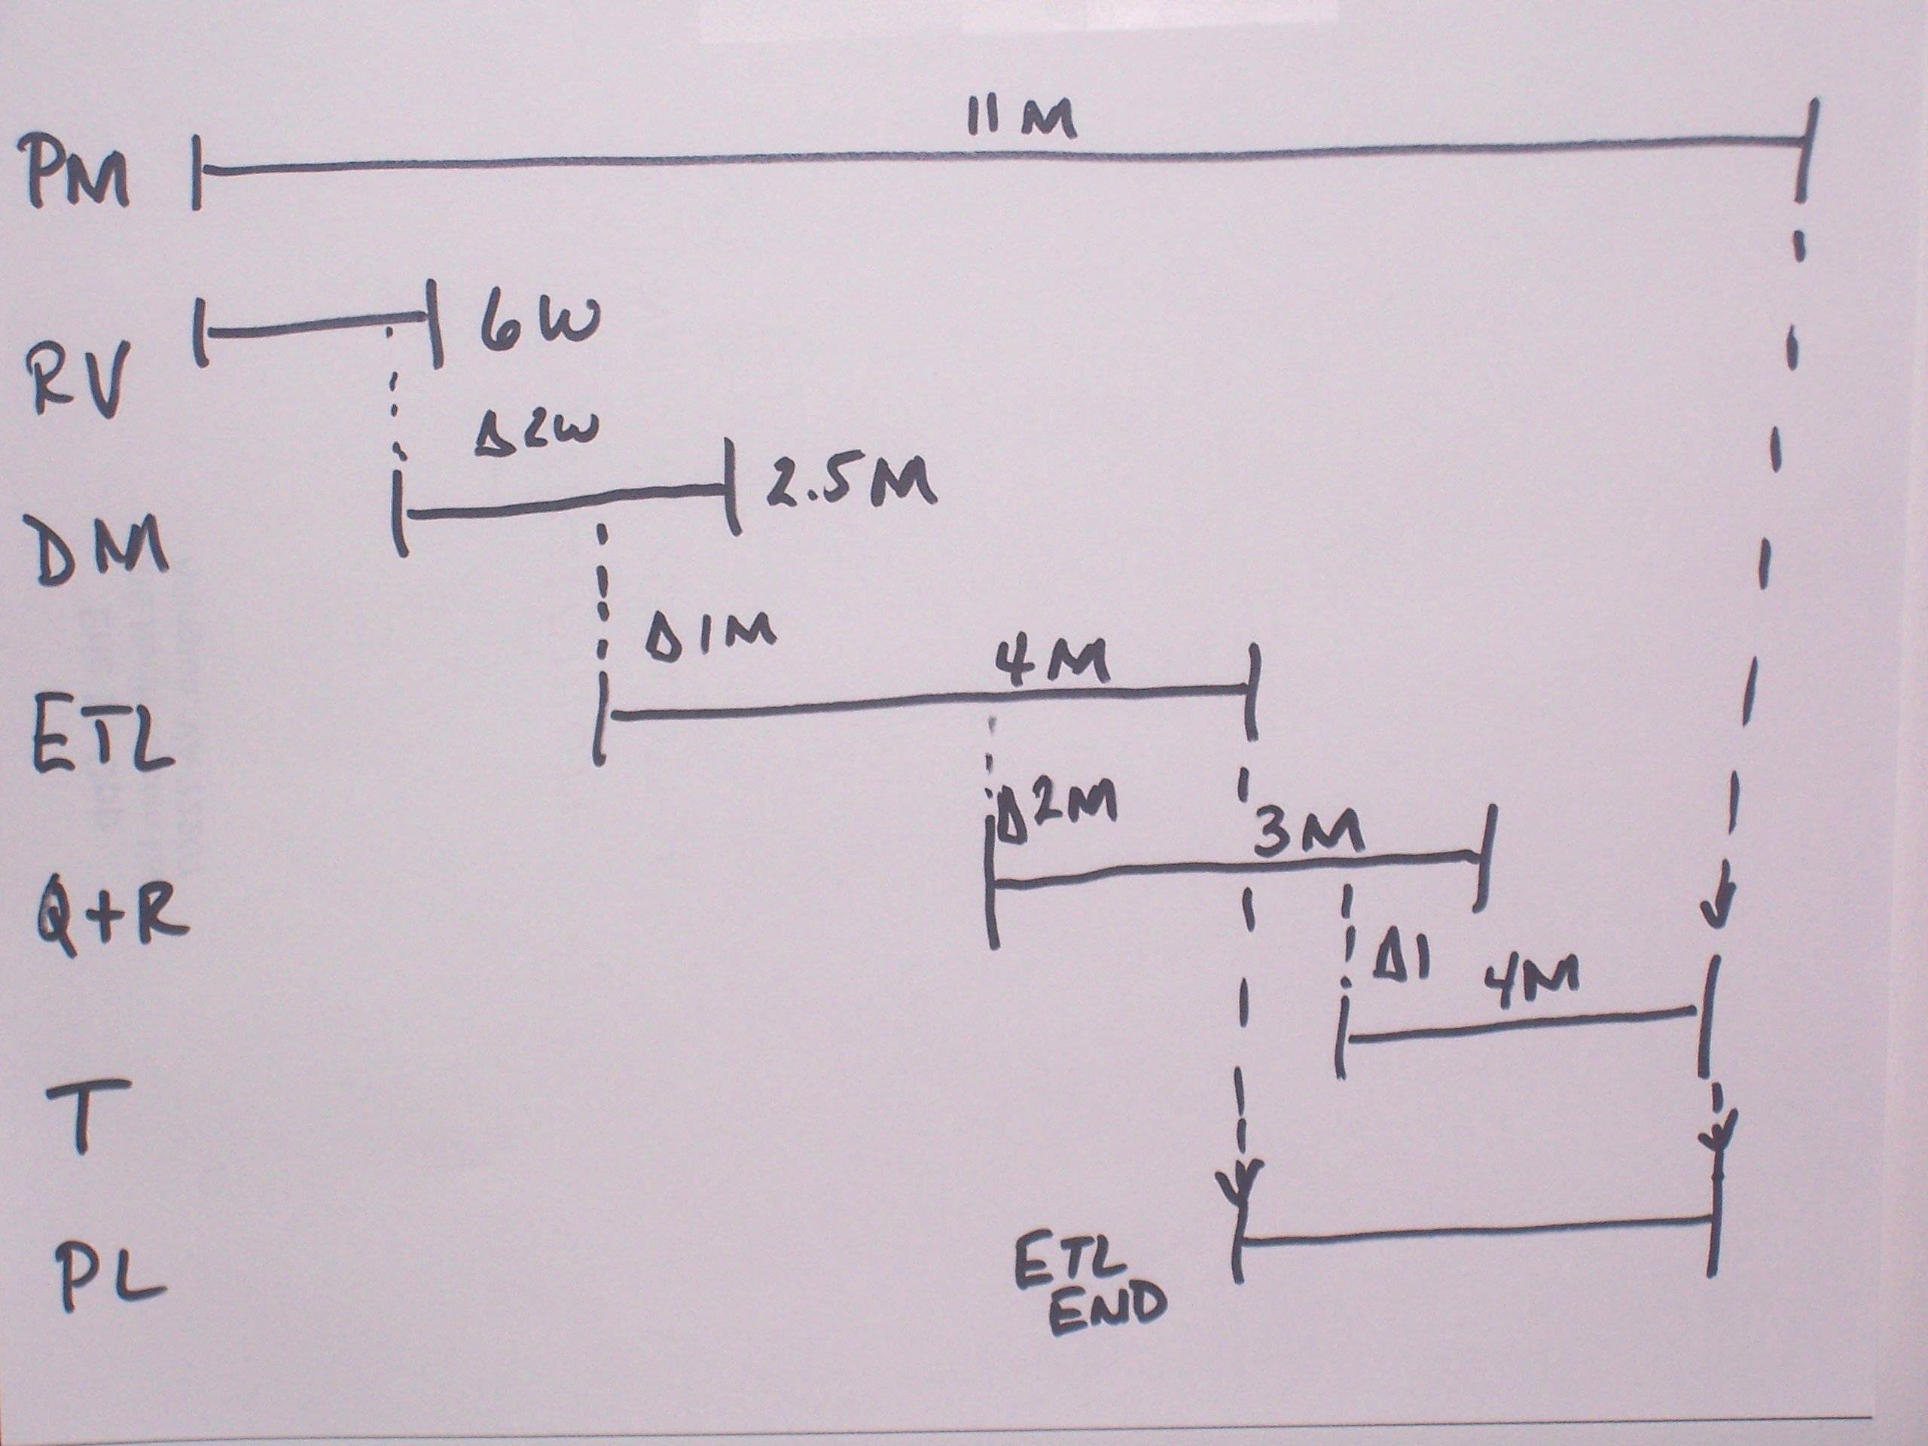
Phasing and Duration

Slide 13
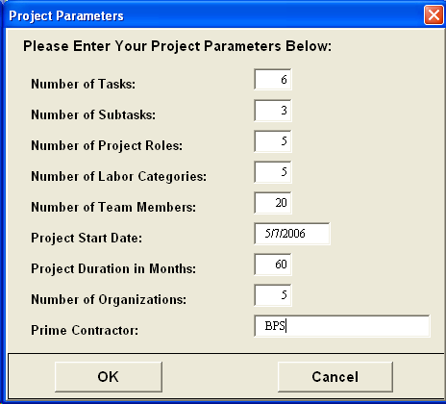
Create Estimating Template
Role – technical or management function that each team member plays on the project
Labor Category – the cost/price rate category that each tam member belongs to
Number of Team Members – count of individuals participating in the project
Number of Organizations– count of the number of companies participating in the project
Prime Contractor – initials used to denote the prime

Slide 14
Can You Produce a Full Project Estimate in Less Than an Hour?
Yes!!

Slide 15
Informal Survey
How many people use:
  XL for estimating?
  MS Project for estimating?
  Neither?

Slide 16
Questions

